Slide 1


MISSION FEST
20
24
VANCOUVER
Feb 15–17 at Westside Church
conference.missioncentral.ca

Slide 2


MISSION FEST
20
24
VANCOUVER
TOGETHER WITH HIM
“THE LORD WORKING WITH THEM”
MARK 16:20
Feb 15–17 at Westside Church
conference.missioncentral.ca

Slide 3
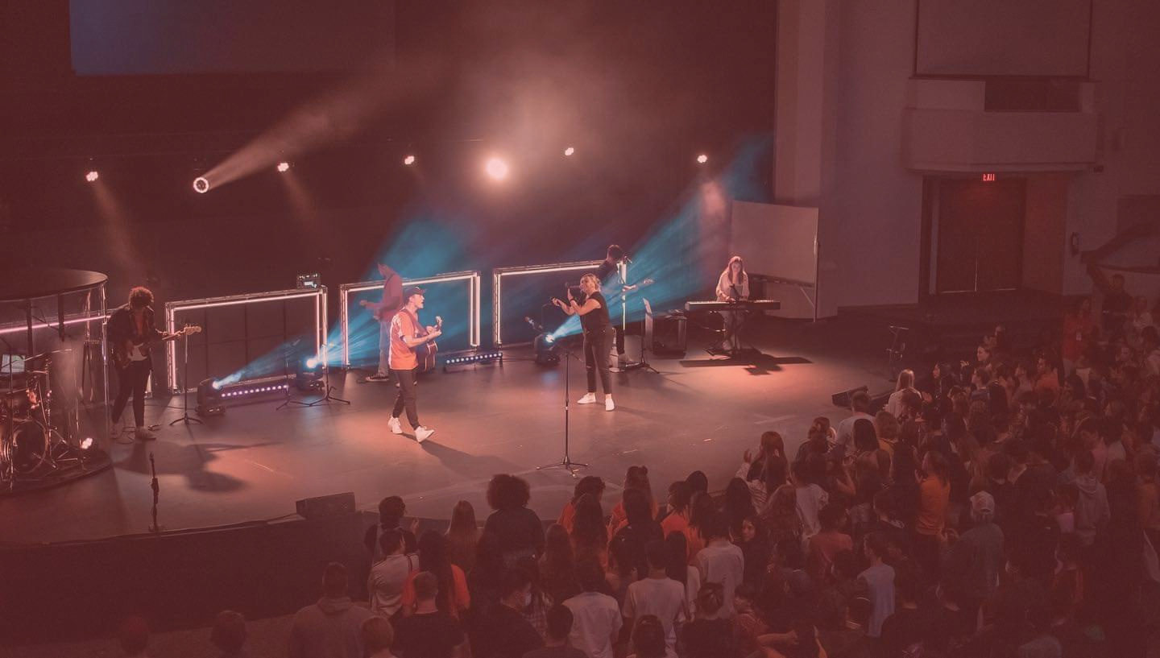

MISSION FEST
20
24
VANCOUVER
YOUTH ENCOUNTER
RYAN
JOHNSON
JONATHAN
MITCHELL
with worship led by
6pm, Friday Feb 16, at Westside Church
conference.missioncentral.ca

